Slide 1
Employee Stress Level Reduction

Slide 2


Slide 3
“550 million workdays are lost each year due to stress on the job. Research shows that workplace stress leads to an increase of almost 50% in voluntary turnover.”
-Harvard Business Review
“Stress can lead to fatigue, changes in personality, withdrawal from others and a decrease in enthusiasm, all of which can significantly impact the productivity of your company.”
-Business.com
Notes:
The Center for American Progress estimates that replacing a single employee costs approximately 20% of that employee’s salary

Slide 4
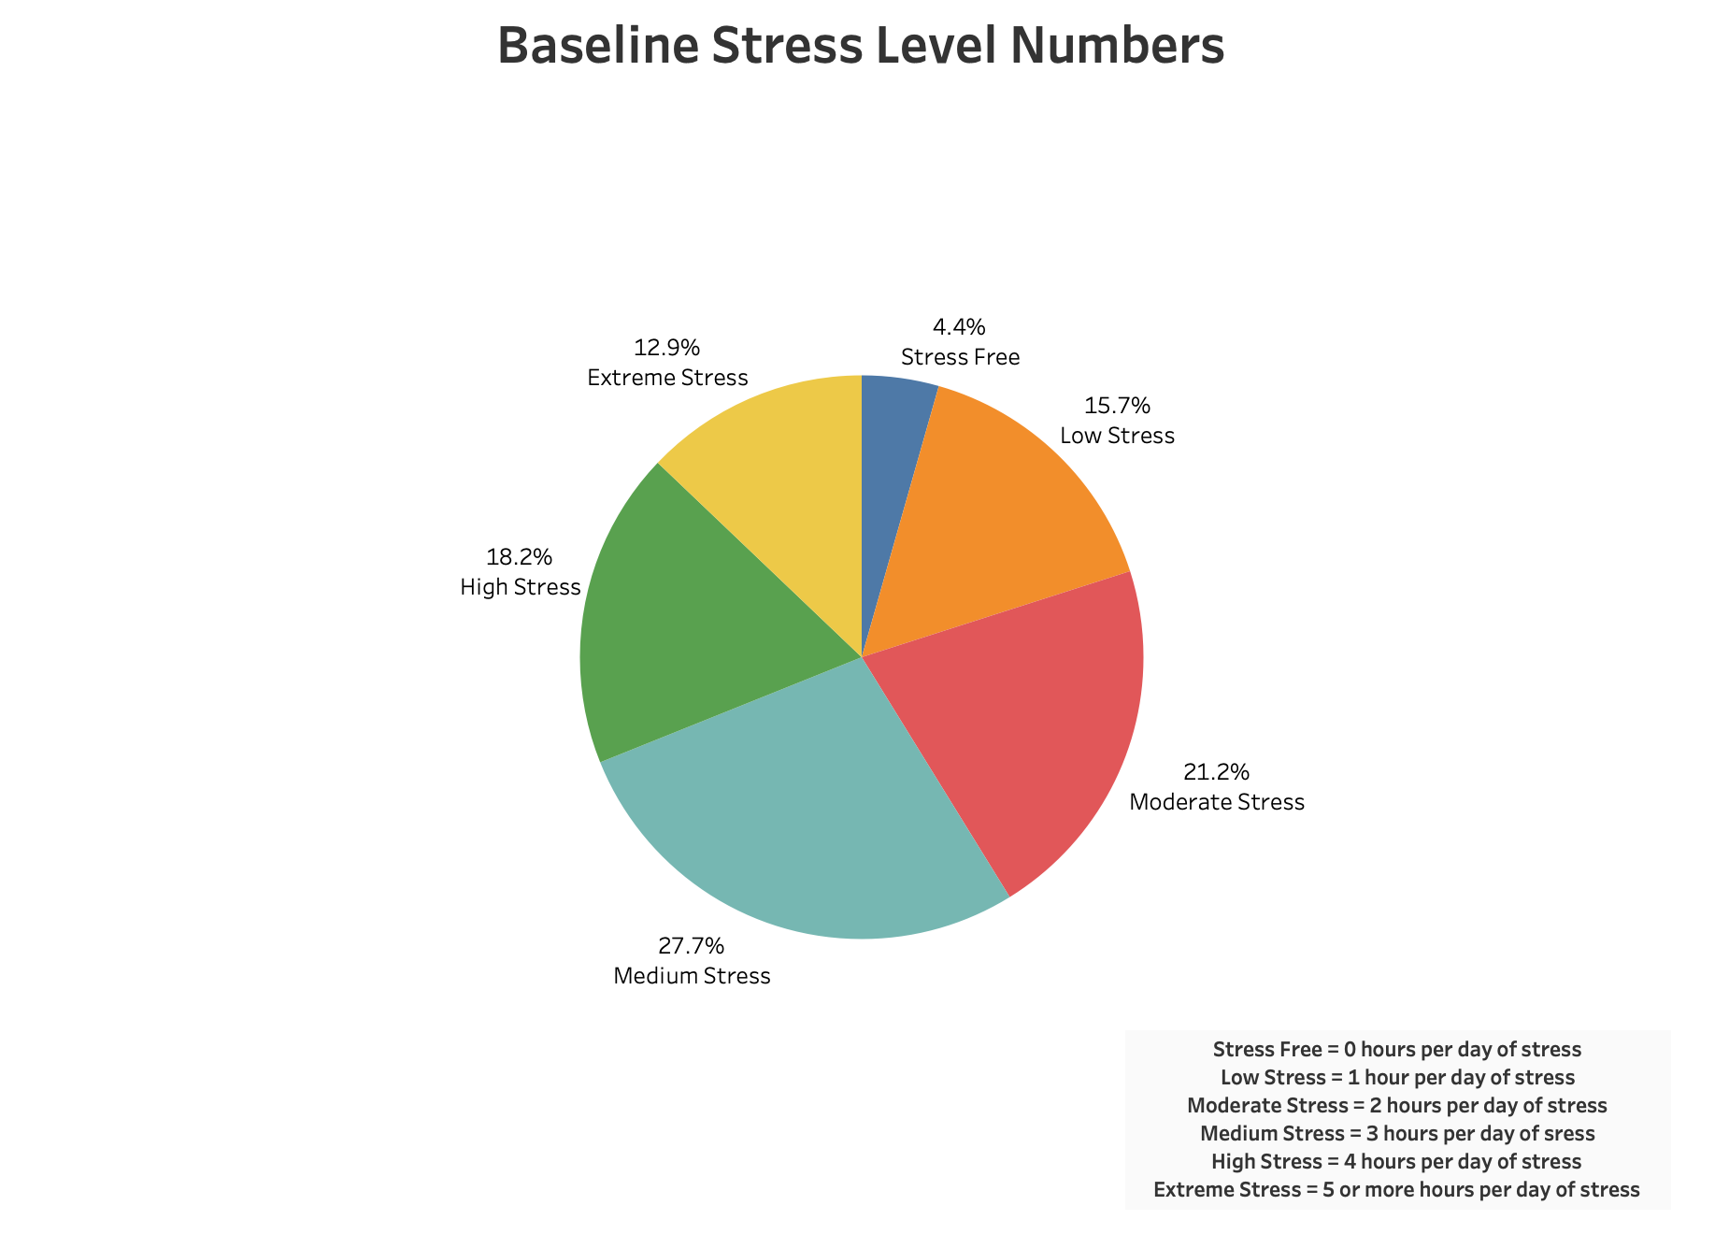
Of over 12K survey respondents, 58% report experiencing 3 or more hours daily stress, while only 42% experience 2 or fewer.
Notes:
Baseline numbers are from 1256 respondents in the US to the global health and wellness survey between 2015 and 2019, in the US. We are making the assumption that our employees experience stress at similar levels across the organization. The survey asked questions about several areas of daily life such as stress levels, time spent on passions, average daily steps, yearly awards, and others. We have focused our analysis only on those areas that can be reasonably affected through workplace initiatives.

Slide 5




z
Our Goal: Reduce Employee Stress Levels by 20% in 2021-22 to Increase Productivity and Overall Workplace Satisfaction

Slide 6

z
Not every factor was significant

Slide 7
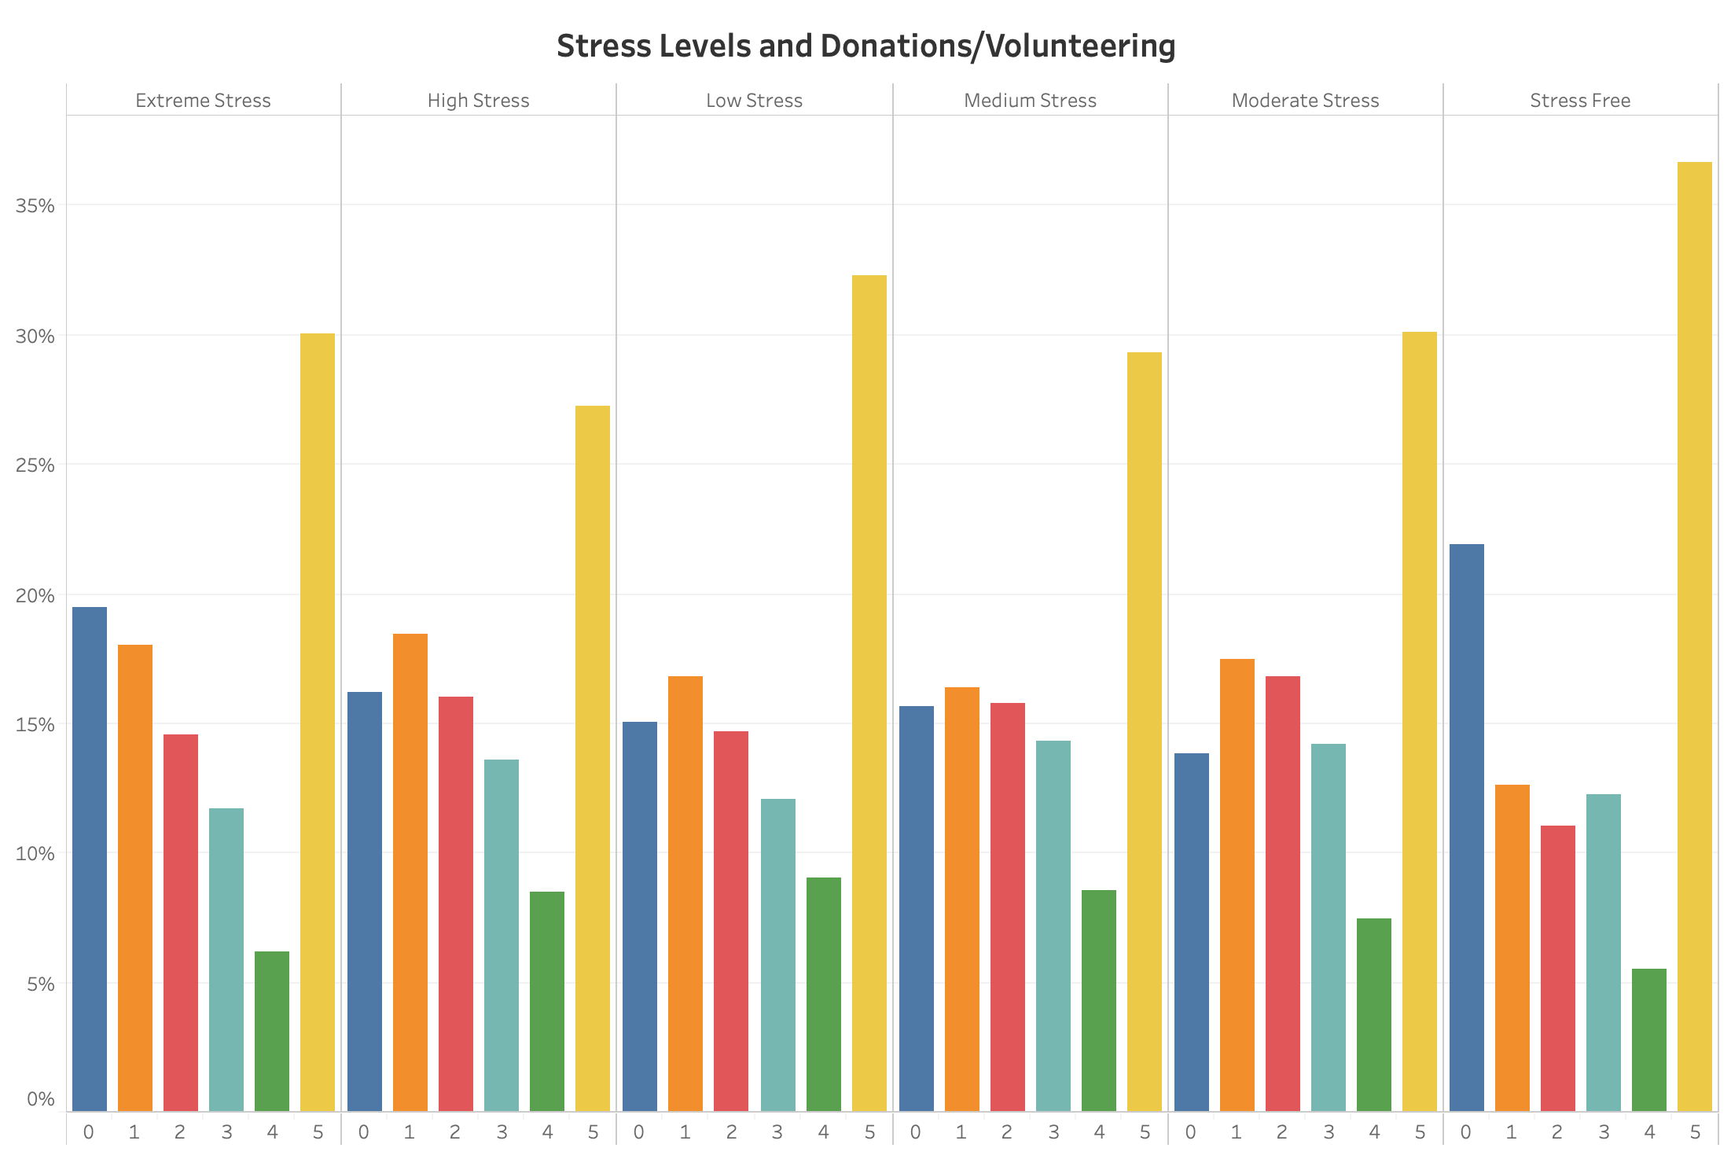
Stress free individuals are slightly more likely to donate time or $ to a charitable cause 5 or more times per year, but also more likely to donate zero times per year

Slide 8
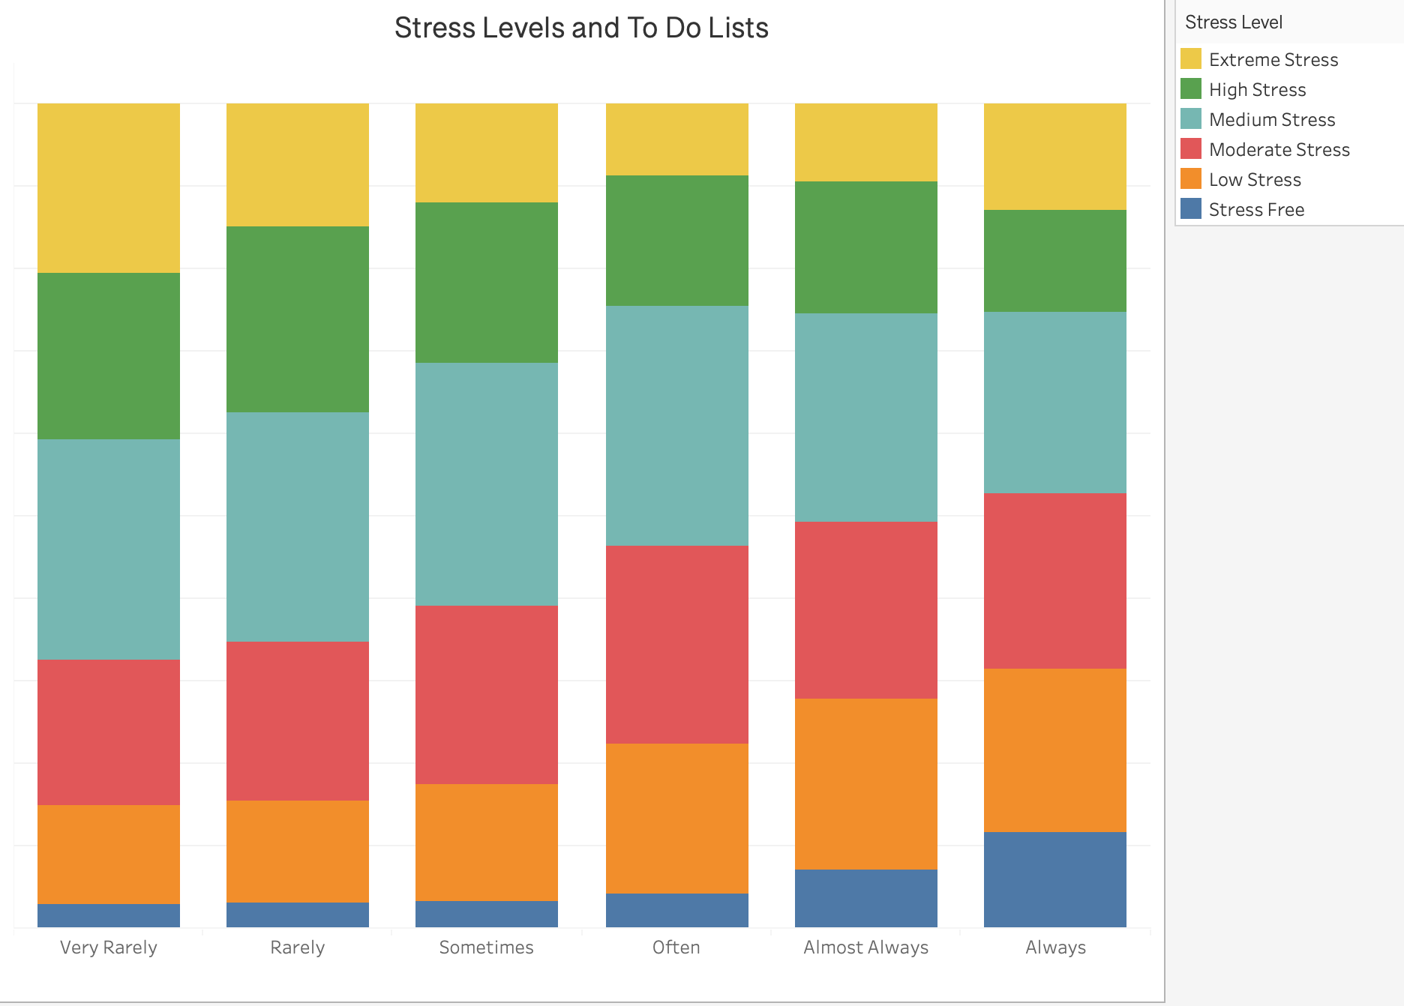
Extreme stress individuals are more likely to very rarely finish “To Do” Lists but the difference in the other categories, especially “Always” was not significant enough to warrant a separate initiative.
21%
3%
Notes:
Though the connection here was not as strong, stress free people are more likely to report always finishing their “to do” lists while those experiencing extreme stress are more likely to report very rarely finishing their lists.

Slide 9
Four Key Factors
Average Daily Step Count
Daily Fruits and Veggies
Time Spent on Passions
Lost/Unused Vacation Days
z

Slide 10
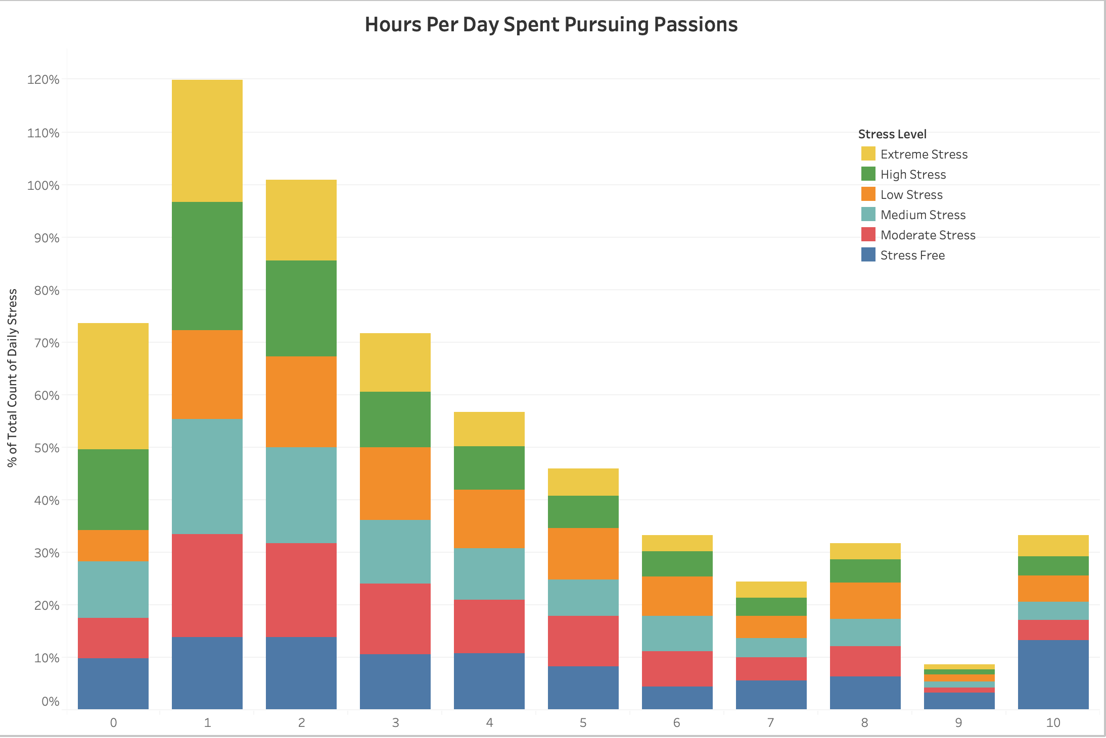
Extreme stress individuals 14% more likely to report spending 0 hours per day on passion projects
24%
10%
Hours per day spent doing something you are passionate about

Slide 11
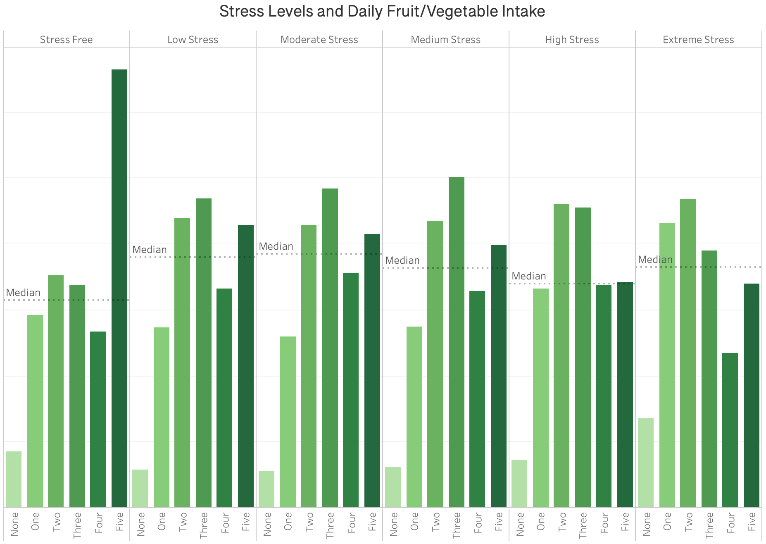
Stress free individuals much more likely to eat 5 more more fruits or vegetables per day
Daily Fruit/Vegetable Intake

Slide 12
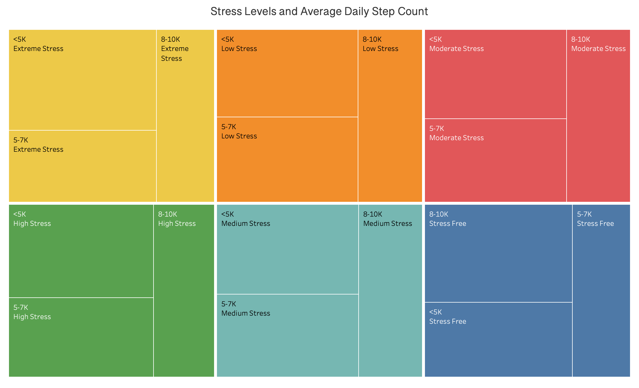
The majority of extreme stress individuals take fewer than 5K steps per day while the majority of stress-free individuals take 8-10K steps per day
42%
28%
41%
28%
Average Daily Step Count
Notes:
Change title to: Stress Free people tend to take 8-10K steps every day, while Extreme Stress people tend to take less than 5K steps every day

Slide 13
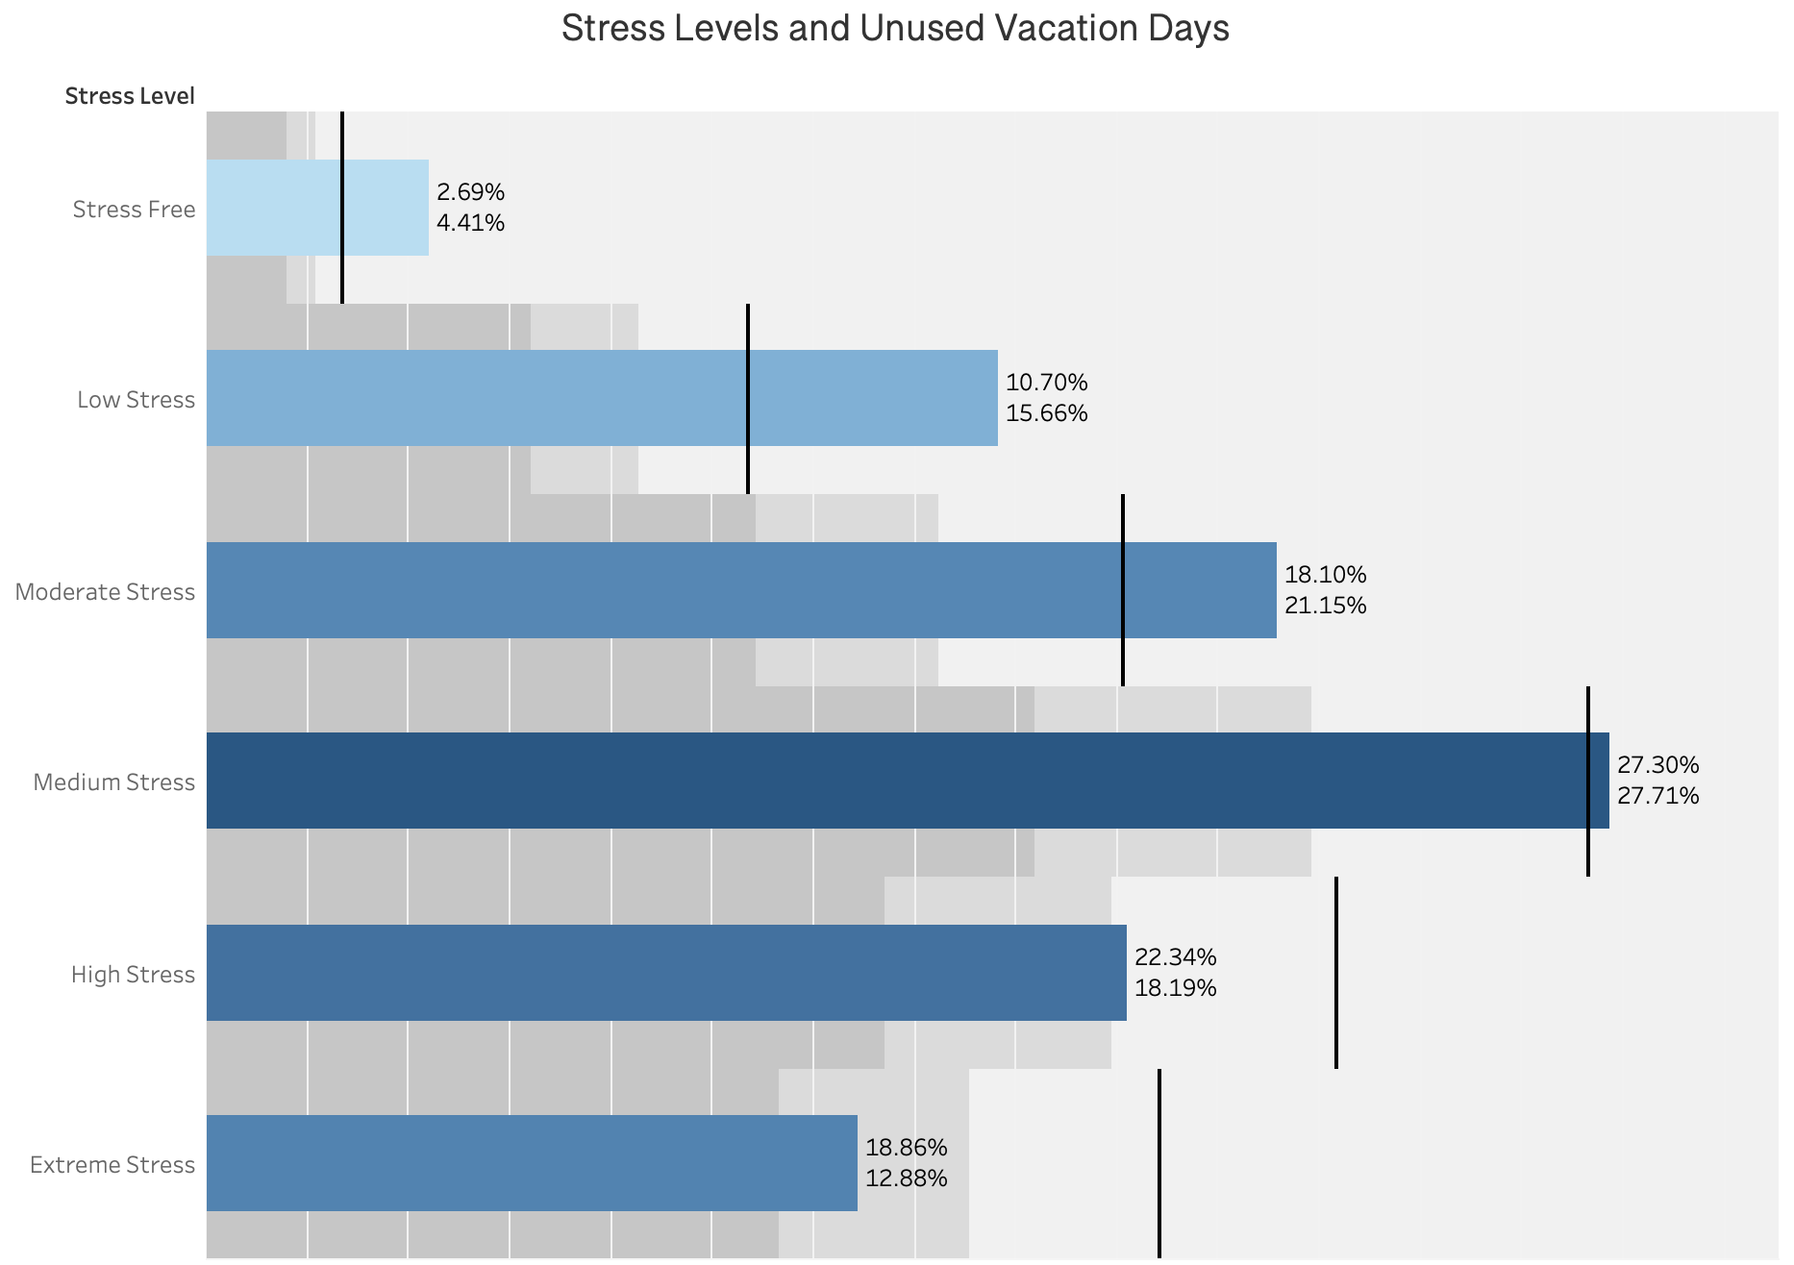
Ensuring that all employees use available PTO alone could reduce stress levels by 20%
41% of respondents
31% of unused vacation days
59% of respondents
69% of unused vacation days
Stress Levels and Unused Vacation Days
Notes:
Unused vacation days are the most obvious culprit for increasing stress levels. Moderate to stress-free individuals account for 41% of those surveyed but only 31% of the unused vacation days. Contrast that with those experiencing 3 or more hours of stress per day, who make up 59% of those surveyed and a whopping 69% of the unused vacation days! Ensuring that employees use all of their vacation days could potentially reduce stress levels by 20% without addressing any of the other factors.

Slide 14

z
Step one: have all team members take a baseline stress survey
Notes:
These will be anonymous. A link will be sent via email from HR.

Slide 15
Stress Reduction Initiatives
z
20% Project
Fitbits for Employees
No Lost Vacation Days
Catered Healthy Lunches
Notes:
But of course, we do want to address these other factors as well

Slide 16

z
20% Project
Notes:
The 20% Project is an initiative where company employees are allocated twenty-percent of their paid work time to pursue personal projects.

Slide 17

z
Weekly Catered Healthy Lunches
Notes:
There will be an announcement made in the company newsletter. No action necessary from management other than encouraging employees to eat. Managers who provide snacks to their teams should consider providing fruit and veggies as opposed to chips and cookies.

Slide 18
Fitbits for All Employees
Weekly Step Count Contests With Prizes
z
Notes:
Managers responsible for distributing fitbits. Please encourage your team members to participate.

Slide 19

z
No Lost Vacation Days
Notes:
Managers will be expected to check in regularly with team members to schedule time off and ensure adequate coverage. Upper leadership will check in with managers to ensure they take their vacation days as well. This initiative is the most important and impactful!

Slide 20

Notes:
At the end of the year, employees will take the stress survey again, hopefully with improved results!

